Slide 1
CryptoTracker™

Slide 2
Overview of Our Process
Real-time Cryptocurrency Awareness
But How Does It Work?
iOS Application Interface
Logistics and Resources

Slide 3
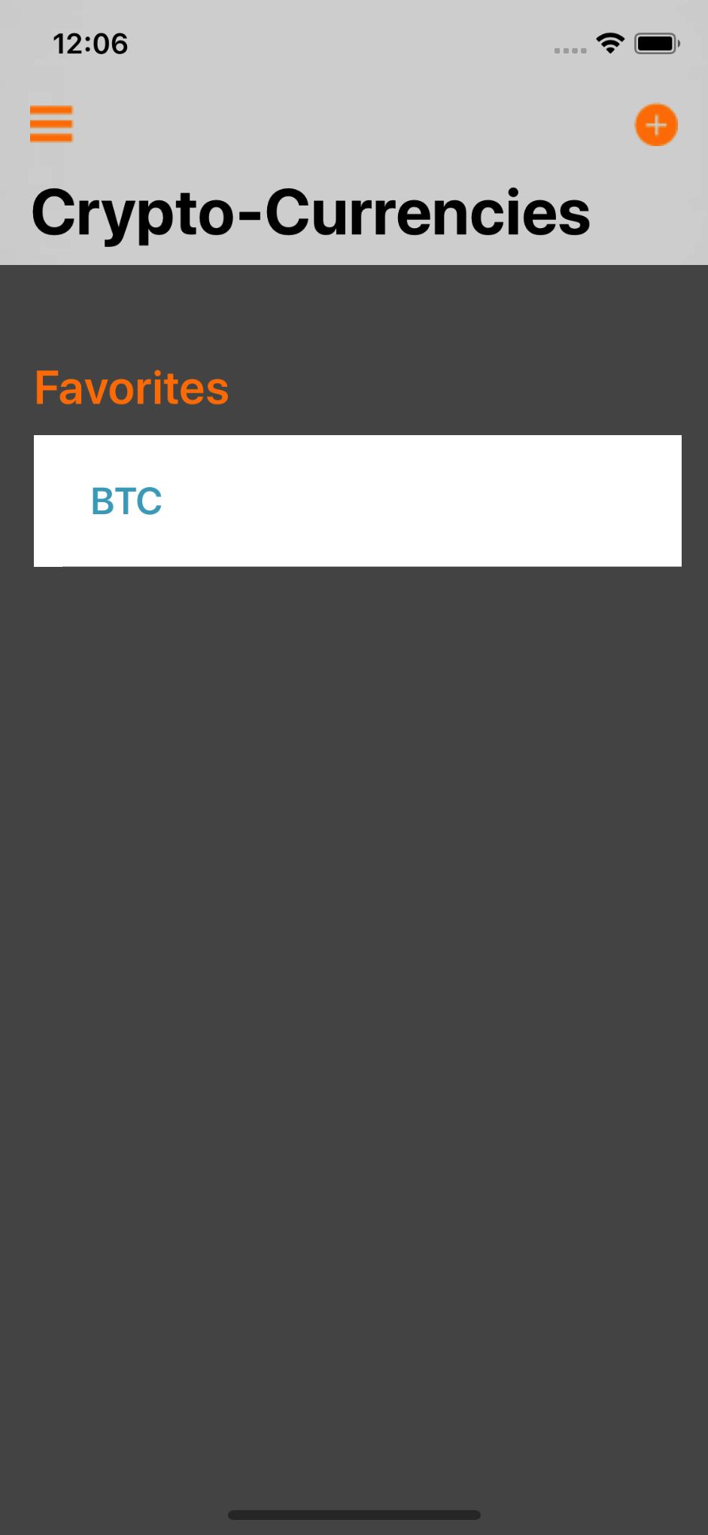
Mobile Application Interface (iOS platform)
Easy access and user-friendly. Allows individuals to choose current cryptocoin display.

